Slide 1

Demo ML Quota Tickets Project All Data has been altered from Original Project Data

Slide 2
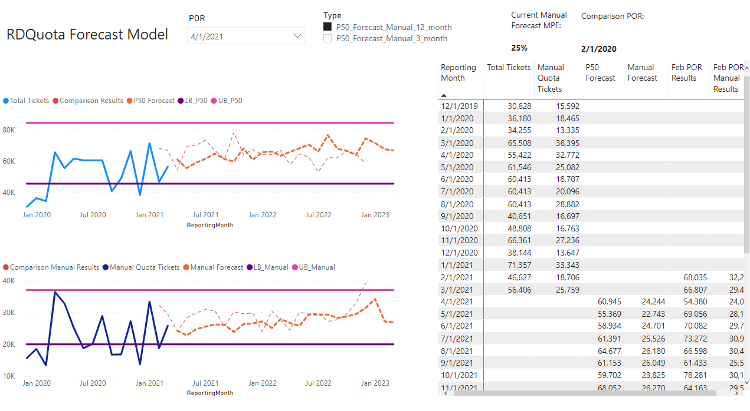
Major Cloud Provider: Created Generic Forecasting Model For Quota Ticket Submissions
Quota Ticket Volumes are used to plan for two-year vendor capacity contracts
Quota Tickets are created from requests to increase cloud capacity
Upper Limit bounds ensure up-to-date customer SLA

Slide 3
Upgrade to Lump event Model : Two Part Vision is to: Understand recurring events (Big Enterprise Customers and one-time events (Batch customer workloads) Add more features to the Model reacting to: Launching New Regions Capacity constrained Regions New Product introductions Lower grained Forecasts may not improve accuracy, but may provide additional insights

Slide 4
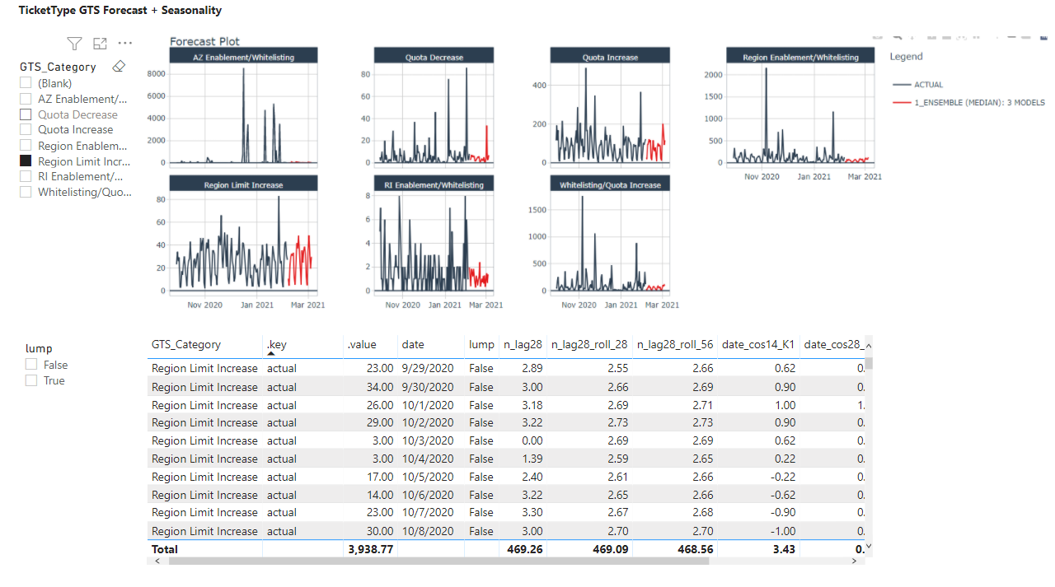
Model Phase II: Reoccurring Events/Seasonality
Grouped Time Series Forecasts (GTS) allow us to provide seasonality to stockholders at different groups
ML time-series Model to drive seasonality

Slide 5
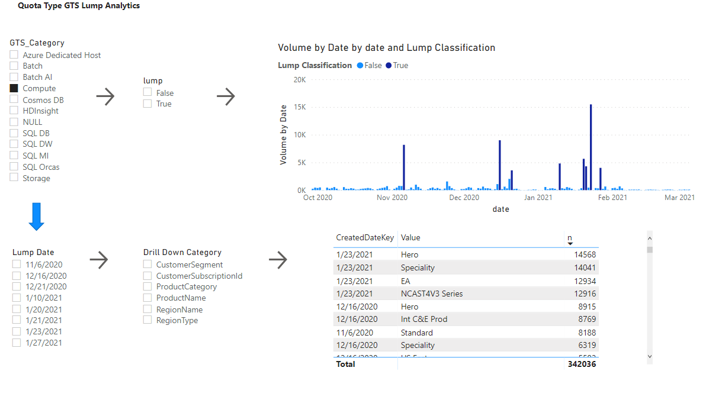
RDQuota Phase II: Lump (One time Events)
1
InterRange Quantile Classification to flag lump events within GTS time series (Compute shown)
1
2
Lump events shown
2

Slide 6
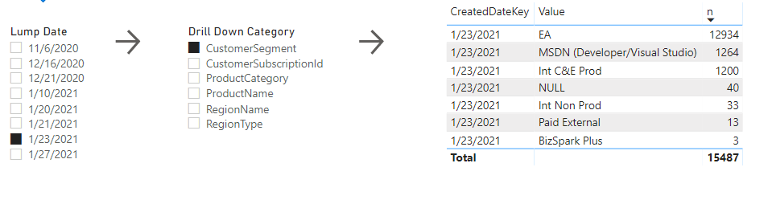
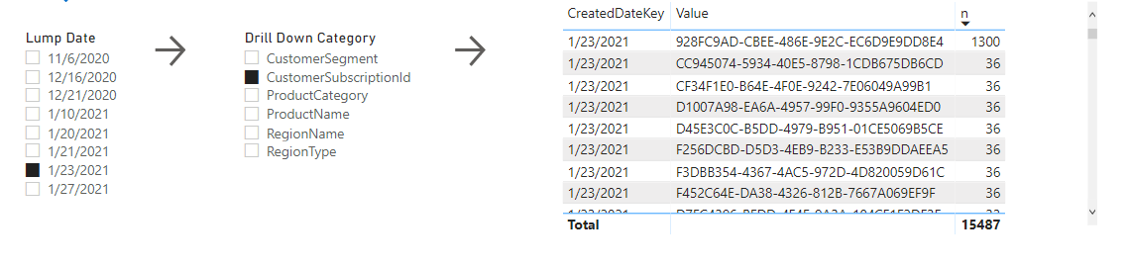
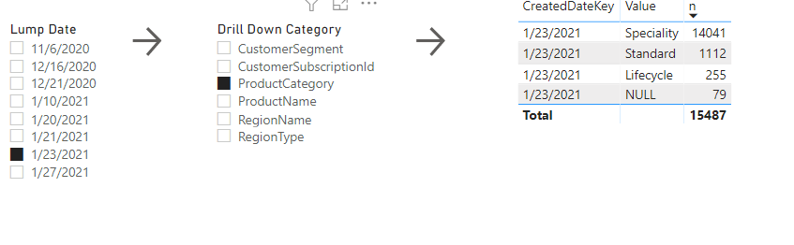
RDQuota Phase II: Lump (One-time Events)
3
Drill down of 1/23/2021 Lump Event within SKU time-series
Stale SKUs for Demo Slides
3

Slide 7
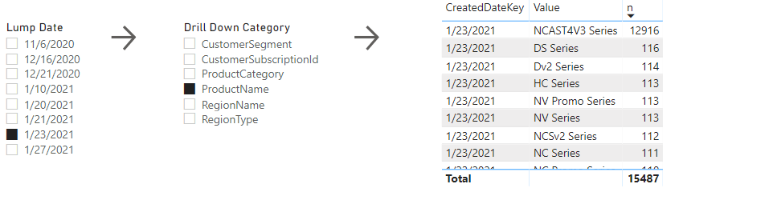
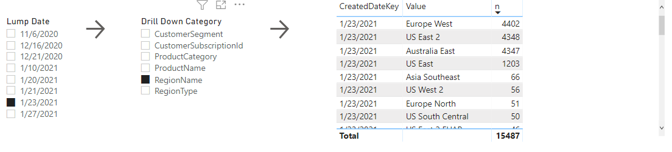
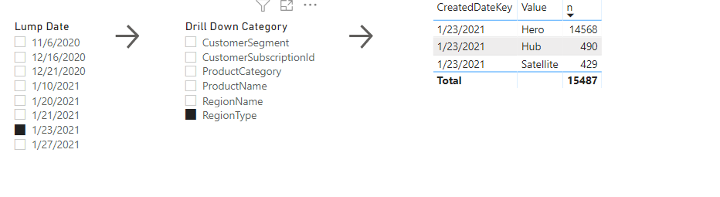
RDQuota Phase II: Lump (One-time Events)

Slide 8
RDQuota Phase III Goals
In Phase II we have achieved:
High performance decomposition of Seasonality within different groups
Classification of one-time events within time series groups
Drill-down analytics on classified one-time events
Phase III Goals
Triangulate DC-Constrained Regions, Hot-Regions, and New Region/AZ/Skus against lump classifications
Provide expected volume breakdowns for one-time events
Predict one-time events (Reach goal)

